Slide 2
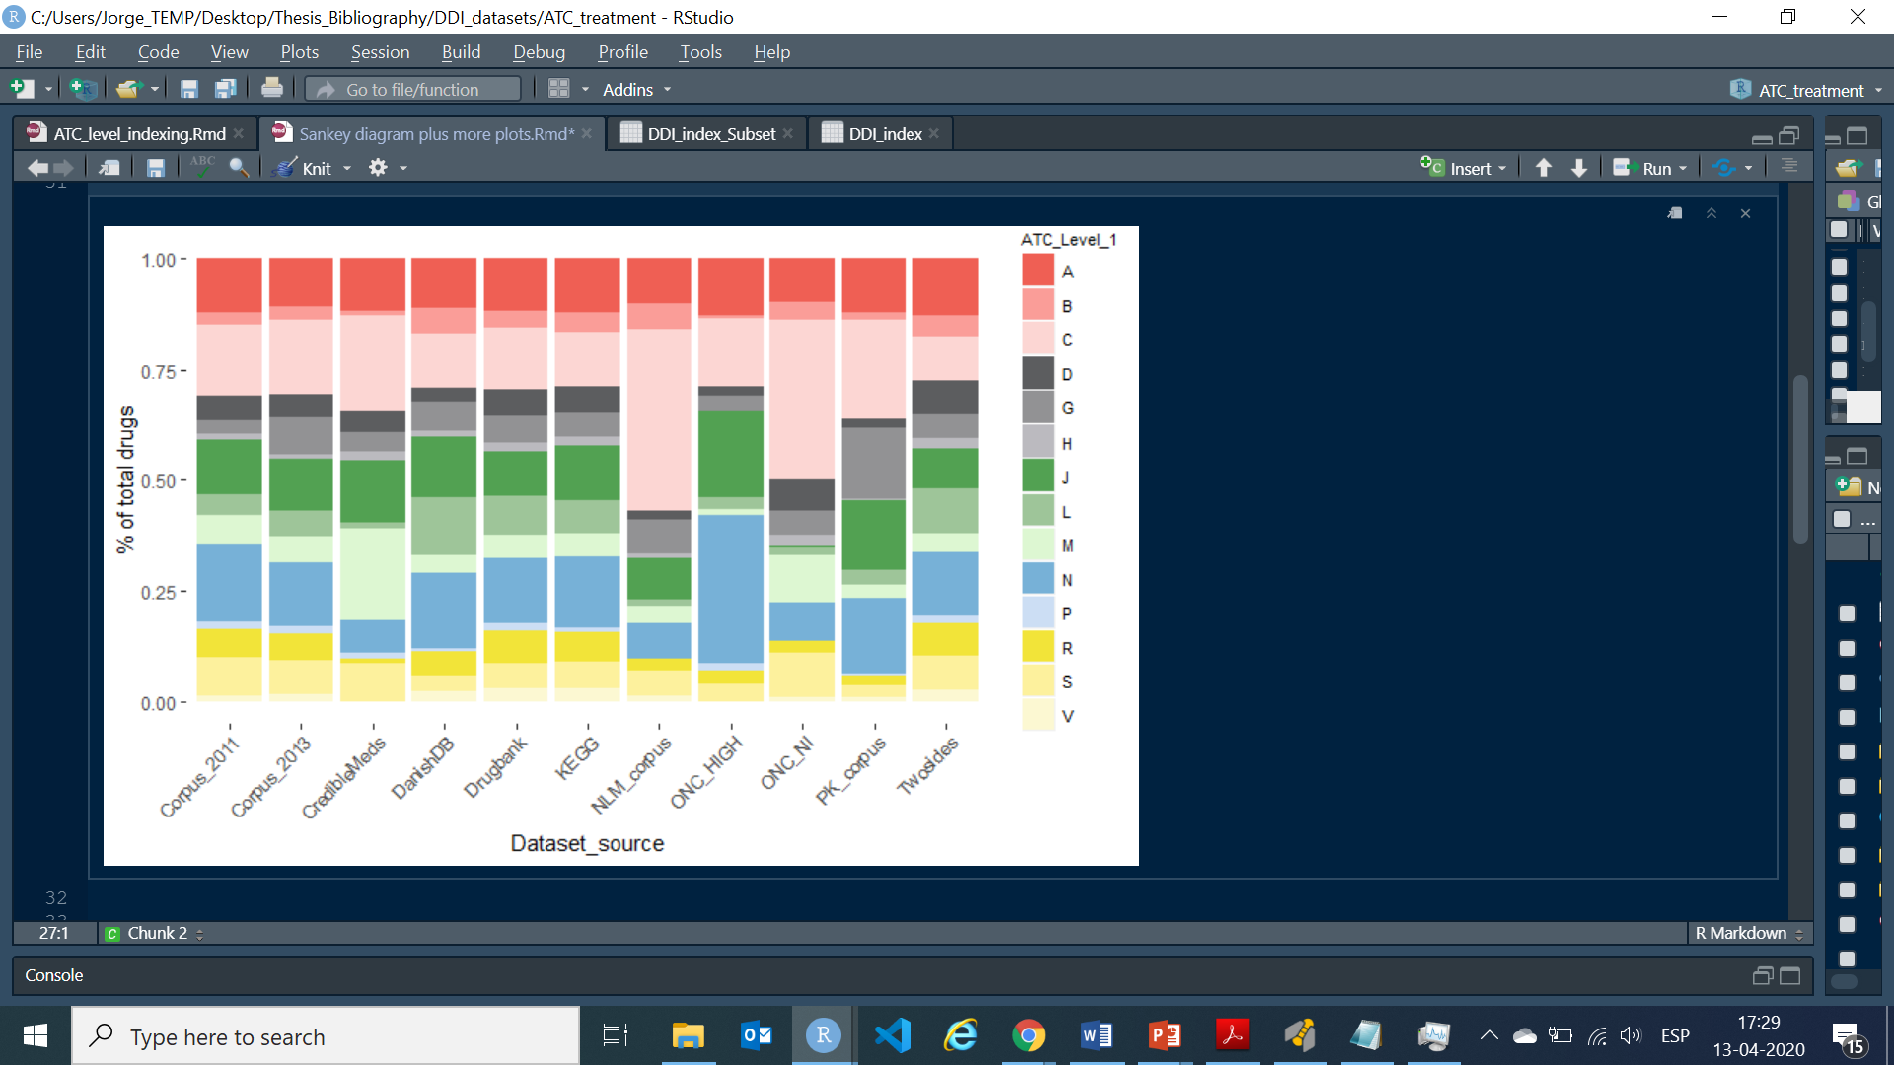
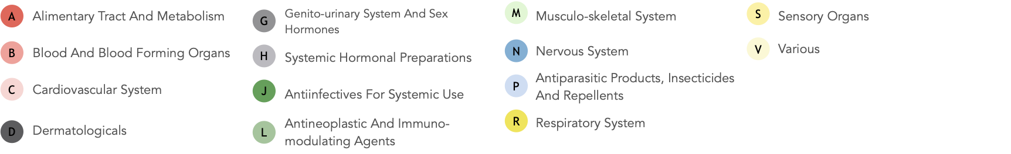
ELUCIDATING DRUG-DRUG INTERACTIONS UNDERLYING DRUG POLIPHARMACY PROFILES.
Retrieving publicly available drug-drug interactions (DDI)
Factorizing DDI features
Characterization of DDI to find significant patterns
Find overrepresented data to focus on
Network analysis
Stablish DDI hubs network
Find relationships between features
Finishing 22th June!

